Slide 1
SHERPA X Governance Foundation FY25 Fit-2-Standard Workshop P2P SRE Direct X
UPDATED by Marcus 2025-01-27
4th February 2025

Slide 2


SHERPA X Governance Foundation FY 2025/2026 Working Assumptions and Workshop Etiquette
UPDATED by Marcus 2025-01-17
Keep in mind that a SHERPA X Template introduction means harmonization and standardization of processes and tools
The workshops are being performed for several Companies according to scope statement
Open topics have to be kept and monitored in our open item list
Session will
be recorded
Mute yourselves when you are not talking
Input: use the raise hand functionality
Input: keep it short and crisp

Slide 3
SHERPA X Governance Foundation FY 2025 Fit-2-Standard Workshop Agenda
UPDATED by Marcus 2025-01-21
1. Introduction Purpose of this Workshop Scope Sherpa X Organization Workstream Organization Release Plan and Increments P2R Direct X FY25 | Marcus Fiegert | 20 min
2. SRE Direct X Process and Solution PR Direct Solution Overview (Fiori, BTP, SAT, VIM) SRE P2R Process Manage Purchase Requisition Manage Purchase Order PO Output & PO Response & PO Change | Ajit Gautam / Mahmoud Abushama | 60 min
3. Next Steps | Marcus Fiegert | 20 min
4. Q&A | All | 20 min

Slide 4

SHERPA X Governance Foundation FY 2025/2026 Purpose of the Workshop
UPDATED by Marcus 2025-01-21
Target:
Describe general approach
Identify major deviations from SHERPA X template (gaps)
Identify major interfaces
Identify focus areas for next steps
Knowledge ramp-up of customer

Slide 5
What is SRE Direct X?
UPDATED by Marcus 2025-01-22
P2R Direct Procurement Template in SAP S/4 under BT Governance Foundation (GF)
Purpose is the Building / Construction Project/Service business of SRE
For the avoidance of doubts, beside this template, there is a further P2R Procurement Solution in GF called Indirect X which is out of scope of this workstream.
For SRE Direct X the first Go-Live is for ARE / AUN 426Q / 3003 planned for May 2025 (R.1410).
This call refers to the extension to further ARE / AUN for release R.1420 planned for October 2025.
GF P2P P2R
(SRE) Direct X
Indirect X

Slide 6
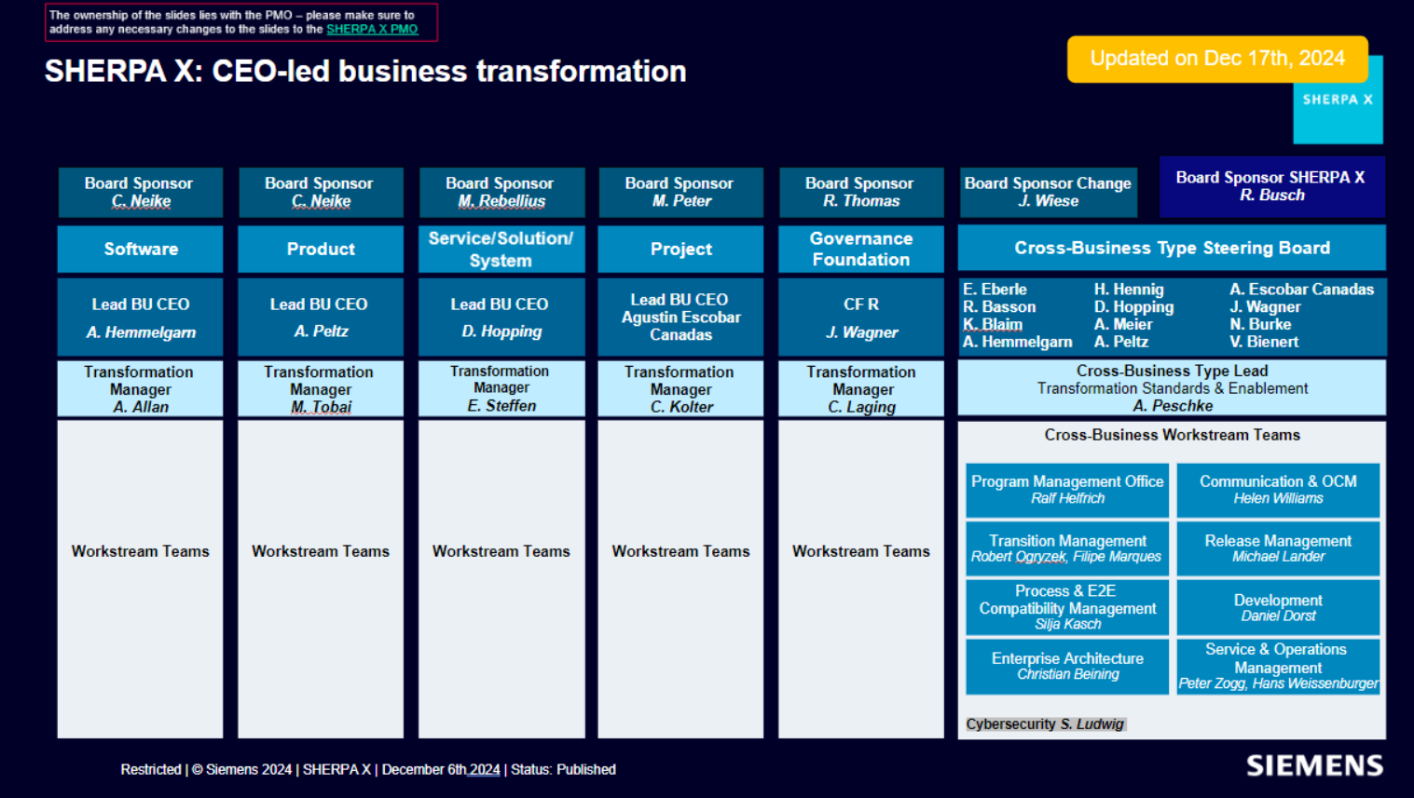
UPDATED by Marcus 2025-01-21

Slide 7
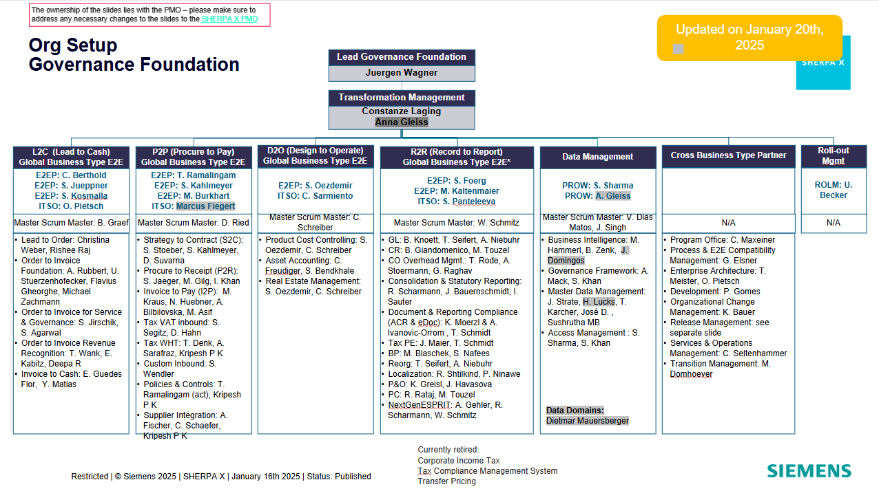
UPDATED by Marcus 2025-01-21

Slide 8
SRE Direct Rollout Team Organization
UPDATED by Marcus 2025-01-28
SRE Lead
Gergana Popgavrilova-Dimitrov (SRE SCM FE) [Deputy: Florian Schmid (SRE SCM FE)]
Sherpa X Rollout Team
Ajit Gautam (IT ECP PLG P)
Himadri Dinodia (IT ECP PLG P)
Marcus Fiegert (IT ECP PLG P)
Elvira Del Castillo (Accenture)
Mahmoud Abushama (Accenture)
Andre Vicente (Accenture)
Harish Velamkanni (Accenture)
Scrum Master
Ismail Khan (GBS ASP PS IN SM)

Slide 9
SRE Direct X Our Incremental North Star journey
To be updated by Marcus/Gergana 2025-01-27
Journey
Phase 1
SRE DE ARE 426Q / 3003
Phase 2
15 SRE DE ARE, SIMEA S.R.L. Sibiu, S' Tec. Serv. Pvt Ltd., (SMO DK, RC CH)
Phase 3
Increments FY26
FY2025
05/2025
(Release 1410)
FY2026
10/2025
(Release 1420)
FY2026ff (Release 1510 and beyond)

Slide 10
Backup: Rollout Overview

Slide 11
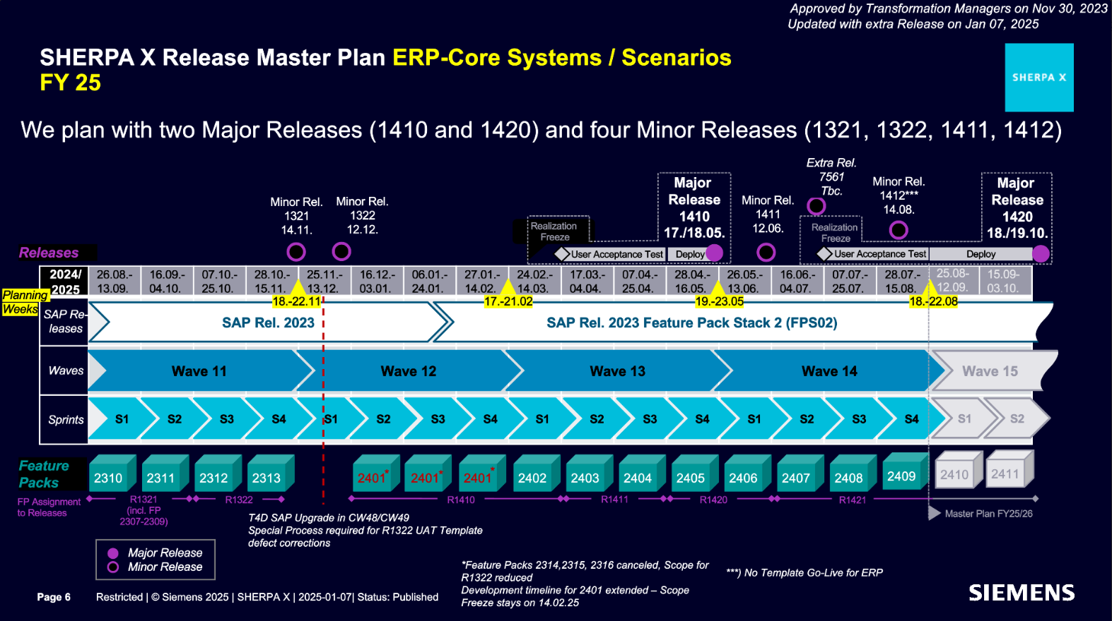
UPDATED by Marcus 2025-01-17
Page 11
Restricted | © Siemens 2025 | SHERPA X | Governance Foundation | P2P SRE Direct X

Slide 12
SHERPA X Governance Foundation FY 2025 Fit-2-Standard Workshop Agenda
UPDATED by Marcus 2025-01-21
1. Introduction Purpose of this Workshop Scope Sherpa X Organization Workstream Organization Release Plan and Increments P2R Direct X FY25 | Marcus Fiegert | 20 min
2. SRE Direct X Process and Solution PR Direct Solution Overview (Fiori, BTP, SAT, VIM) SRE P2R Process Create / Receive Purchase Requisition Create / Receive Purchase Order / Order Change Share Purchase Order with Supplier |  | 60 min
3. Next Steps |  | 20 min
4. Q&A |  | 20 min

Slide 13
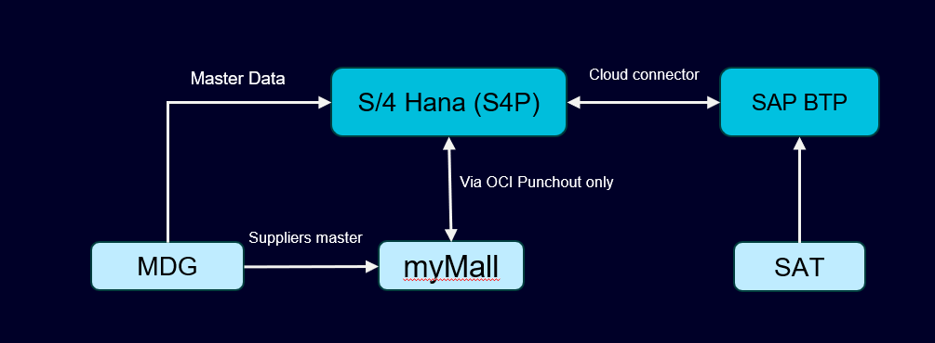
SRE Direct X : Major interfaces
SAP S/4HANA (S4P) : SAP S/4HANA system is the main system in the SHERPAX landscape and S4P is its production system. In the SRE Direct Procurement process, the Purchase Requisition and the Purchaser Order will be created and managed on S4P.
SAP BTP : SAP Business Technology Platform (SAP BTP) is a comprehensive technology platform that integrates various services and tools to help businesses innovate and transform digitally, it is integrated with the SAP S/4HANA to manage the PR/PO forms & approval workflow.
SAT (Mendix) : Signature Authorization Tool (SAT) is SHERPAX harmonized tool to manage the authorized approvers per each Company Code (ARE), Cost Center and Profit Center. The SAT will be used to determine the Purchase Order Functional and Technical approvers.
SAP MDG (M4P) :Business Partners including internal and external suppliers are centrally managed in MDG Creation and/or change of Business Partner data have to be executed in MDG first before such data is available in S4P system (e.g., Purchasing Organization, terms etc.).

Slide 14
SRE Direct X : Features List
Sr. No. | Features Title | Features Description
1. | SX_GF_P2P_Direct_Manage Purchase Requisition | Create/manage Purchase requisition in SAP Fiori (S4) and verification in SAP BTP
2. | SX_GF_P2P_Direct_Manage Purchase Order | Manage Purchase Order in SAP Fiori (S4)
3. | SX_GF_P2P_Direct_Workflow Setup & SAT Integration | PR/PO Technical Release Strategy in S4 PO Approval for Expert Procurement & SAT Approvers in SAP BTP. E-mail notifications related to workflow from SAP BTP
4. | SX_GF_P2P_Direct_PO Output & PO Response & PO Change | PO Output, PO response and PO change process in SAP (S4) via Fiori app.
5. | SX_GF_P2P_Direct_SRE Authorization Roles | Cover the roles of PO Requisitioner, Purchaser, Buyer, Procurement Expert & Approver
6. | SX_GF_P2P_Direct_SRE Organizational Structure | Check organizational requirements in processes for purchasing of direct project and services

Slide 15
SRE Direct X : Roles, Organization & Document Types
Title | Title Name | Description
P2R Roles | Requisitioner | Processes Purchase Requisitions (PR)
 | Buyer | Executes buying activities (eg retrieves quotes from supplier, determines sources)
 | Procurement Expert | Involved in predefined use cases in PO to validate and update data for dedicated purpose
 | Purchaser | Processes PR and creates PO, Order Confirmations and Claims/Returns
 | Approver | Approves POs based on a signature mandate
Organization Data | Purchasing Organization | No IM* Purchasing Organization
 |  | Purchasing Organization per company code
 | Purchasing Group | SRE Functional Group : FXX
 |  | SRE Individual Group : IXX
Document Types in S4P | Standard Purchase Requisition | NB
 | Framework Purchase Requisition | FO
 | Standard Purchase Order | YDNB
 | Framework Purchase Order | YDFO

Slide 16
SRE Direct X : Roles, Organization & Document Types
Title | Title Name | Description
P2R Roles | Requisitioner | Processes Purchase Requisitions (PR)
 | Buyer | Executes buying activities (eg retrieves quotes from supplier, determines sources)
 | Procurement Expert | Involved in predefined use cases in PO to validate and update data for dedicated purpose
 | Purchaser | Processes PR and creates PO, Order Confirmations and Claims/Returns
 | Approver | Approves POs based on a signature mandate
Organization Data | Purchasing Organization | No IM* Purchasing Organization
 |  | Purchasing Organization per company code
 | Purchasing Group | SRE Functional Group : FXX
 |  | SRE Individual Group : IXX
Document Types in S4P | Standard Purchase Requisition | NB
 | Framework Purchase Requisition | FO
 | Standard Purchase Order | YDNB
 | Framework Purchase Order | YDFO

Slide 17

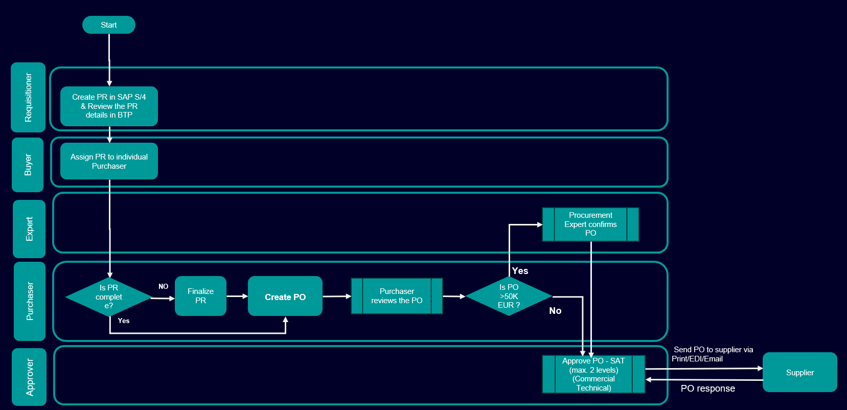
SRE Direct X Process Flow

Slide 18
Purchase Requisition
Create Purchase Requisition (PR) in S4P
To be UPDATED by Ajit
Feature Abstract & Rationale
Details
Requisitioner creates the PR with all relevant information.
A separate confirmation of the correctness of the PR by Requisitioner is required to be able to send the PR to next step.
Afterwards the Buyer receives the PR for further processing.
Buyer identifies the right Purchaser and forwards the PR to Purchaser.
Process description:
Requisitioner creates the PR in S4P via Fiori App assigning the PR to Purch. Org. “C300” and Purchasing Group “Fxx”.
Beside other purchase related details the Requisitioner assigns a valid Account Assignment, the GID of the respective Recipient, and GID of Requisitioner to the PR in Fiori App form.
Account Assignment, Recipient, and Requisitioner fields are verified and controlled by SAP BTP. For Account Assignment the following 3 options are available:
4 – Cost Center without GR
5 – Project without GR
A – Asset without GR
When the PR is saved in S4P, automatically. the Requisitioner receives an email notification from SAP BTP. If SAP BTP notifies about invalid data in one of the controlled fields the Requisitioner has to correct it first in Fiori App before the PR can be confirmed by Requisitioner via link in email notification. Confirmation is mandatory before next process step can be performed.
Buyer receives an email notification from SAP BTP about the confirmed PR.
Buyer checks the PR and assigns it to a Purchaser by changing the Purchasing Group from “Fxx” to an individual Purchasing Group “Ixx” in S4P.

Slide 19
BTP Specific screenshot or report – To be updated by Ajit

Slide 20
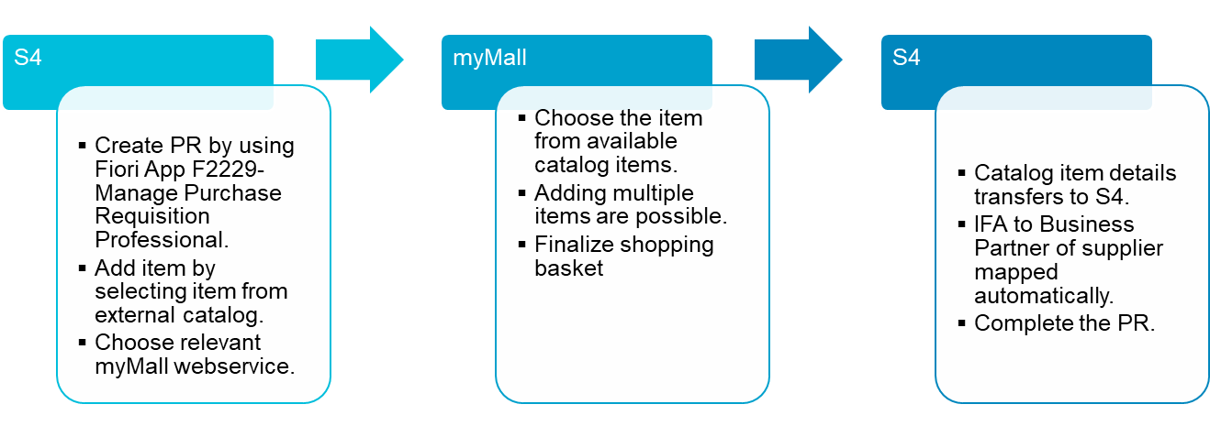
OCI Punchout
OCI Punchout from SAP to myMall to incorporate catalog items into SAP purchase requisition
Feature Abstract & Rationale
Details
Focus for direct business purpose
Leading to
Improved integration to myMall content in case of purchase requisition creation.
Higher usage and leverage of available content in myMall
Increased no-touch rate
Process description:
Entry point for the user is in S4 purchase requisition.
User creates PR in S/4 and wants to incorporate catalogue items
User “punches out” from S/4 to myMall, selects items and checks out to S/4 PR

Slide 21
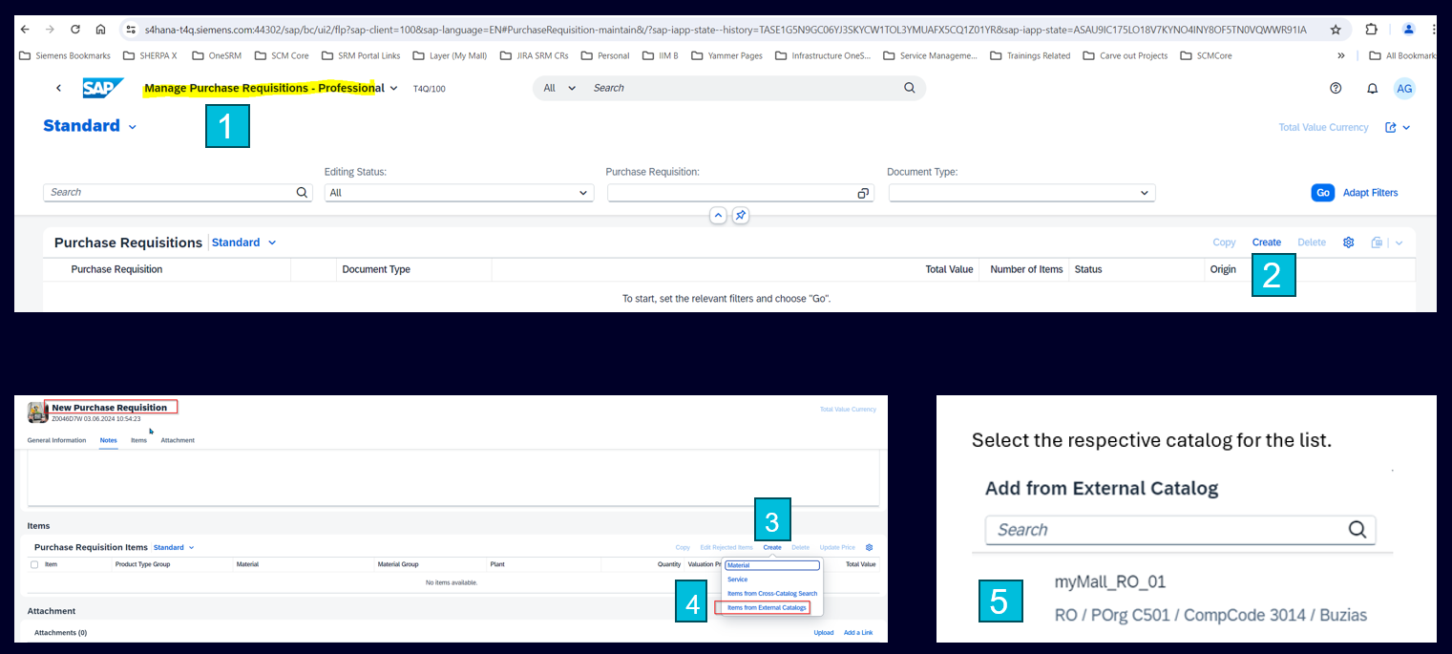
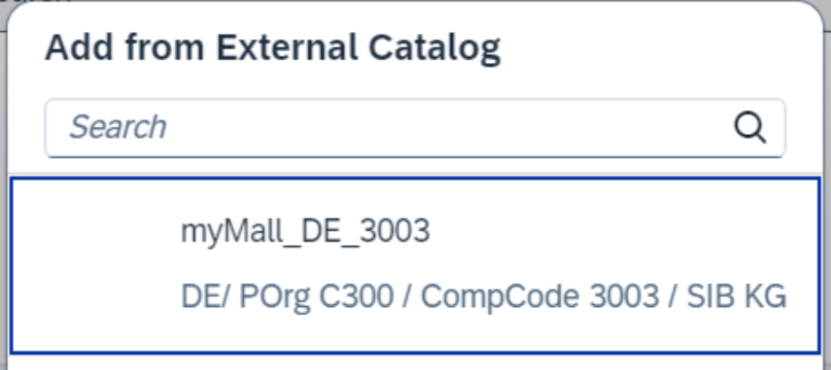

OCI Punchout Process Steps (1/2)
Updated on 27.01 by Ajit
Go to manage Purchase Requisition Professional Fiori app
Click on create.
Click on create at line-item level
Select Items from external catalogs.
Choose relevant myMall webservice
Choose the item from available catalog items.
Finalize shopping basket
Special OCI Role will be assigned to requisitioner role to control the visibility of webservice based on AUN.

Slide 22

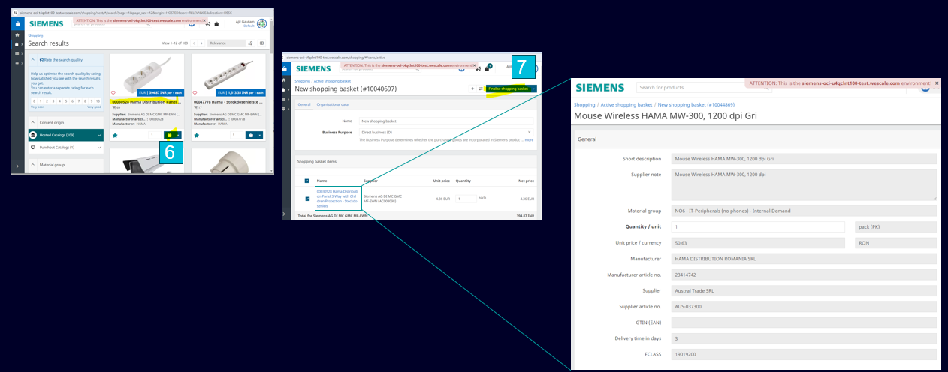
OCI Punchout Process Steps (2/2)
Updated on 27.01 by Ajit

Slide 23
Purchase Order
Create Purchase Order (PO) in S4P
UPDATED on 30.01 by Mahmoud
Feature Abstract & Rationale
Details
How to determine the Procurement Expert?
Purchaser receives PR, verifies it and creates the PO.
When PO is complete the Purchaser acknowledges the PO, and the PO approval process will start.
For POs above 50 kEUR an additional step of a Procurement Expert check and confirmation is required before the approval can be performed by the Approver(s).
Process description:
Purchaser receives a notification for an assigned PR via SAP BTP email notification. The Link to the PR is part of this notification.
If the PR is not assigned to a supplier, the Purchaser determines the correct supplier (outside S4P) and updates the PR.
If the Requisitioners includes the correct supplier number in the PR, then the Purchaser can directly convert the PR to a PO in S4P via the Fiori App.
After creating the PO, the SAP BTP will send an acknowledgement notification to the Purchaser to check and confirm the PO data.
After the Purchaser confirmation, an automatic check on PO will be executed to determine if a Procurement Expert approval is required or not
Procurement Expert is required, if the assigned individual Purchasing Group (Ixx) is not an Expert and the PO total value is higher than 50 kEUR.
Procurement Expert is doing a quality check of the PO in S4P and acknowledges it via SAP BTP email notification.
Afterwards the SAT approval is started for POs above 1 kEUR for maximum 2 approval levels (Functional and Commercial).

Slide 24
Purchase Order Approval
Harmonized approver determination via Signature Authorization Tool (SAT) and parallel approval workflows
UPDATED by Marcus 2025-01-27
Feature Abstract & Rationale
Details
New SAT is incorporated in S4P and as well in (SRE) Direct X and acts as single source of truth
SAT is a global tool and contains the Approvers per Company Code, Profit Center and Cost Center based on the Limits of Authorization (LoA)
For POs with a value above 50 kEUR, 2 approvals per PO are required. Those will run in parallel.
Decided PO Approval Cornerstones
Harmonized PO Approver determination via SAT based on Company Code, Profit Center and Cost Center
PO Value (EUR/limit)​ | SAT Approval Level | SAT Approval Level value | Functional | Commercial
Below 1,000 | 1 | 1,000.00 | N | N
Below 50,000 | 2 | 5,000.00 | Y | N
 | 3 | 25,000.00 | Y | N
Above 50,000 | 4 | 50,000.00 | Y | Y
 | 5 | 100,000.00 | Y | Y
 | 6 | 500,000.00 | Y | Y
 | 7 | 1,000,000.00 | Y | Y
 | 8 | 5,000,000.00 | Y | Y
 | 9 | 10,000,000.00 | Y | Y
 | 10 | Unlimited | Y | Y

Slide 25
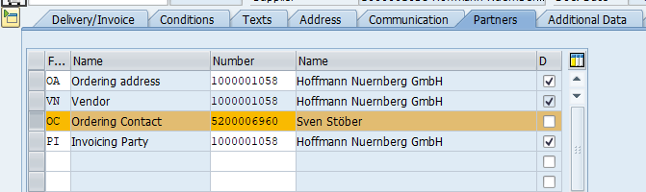
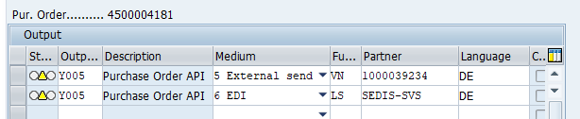
Check which supplier data can be modified with Nazli
Purchase Order Output
Output Determination
to be updated by Mahmoud
Feature Abstract & Rationale
Details
One output method and determination logic and one print form for Direct POs with process / unit / language specific text module definition
Output Mediums are EDI or Email and automatically determined based on Supplier settings (EDI first)
PO output (Y005) will be sending immediately to the supplier and a copy of will be attached as PDF to the PO for archiving
Supplier contacts is assigned to the “OC – Ordering Contact”
Predefined texts in printout are controlled by the respective Company Code, Purch Org, PO type
Decided process driven by BT Product:
On PO creation based on supplier data output will be automatically determined and set
During PO processing the Supplier contact, the email address and the relevancy of output will be copied from the “OC – Ordering Contact”
On PO release (last workflow step has been approved) the set messages will be executed and send out
Supplier receives PO (EDI / Email)

Slide 26
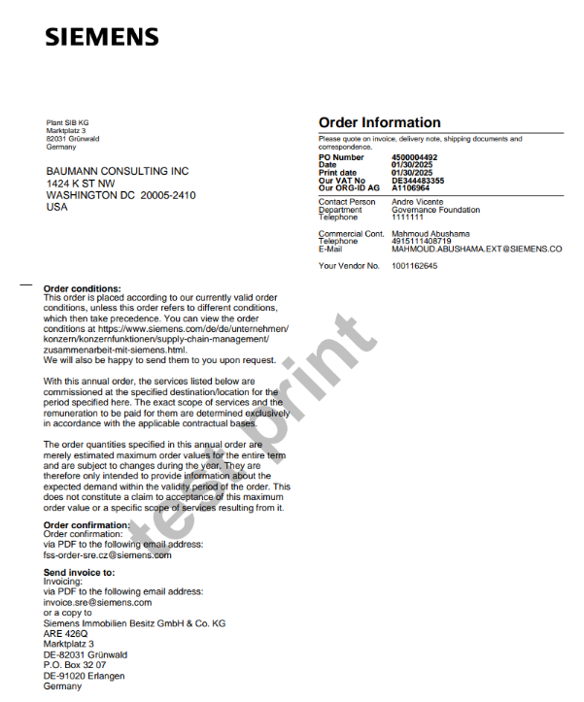
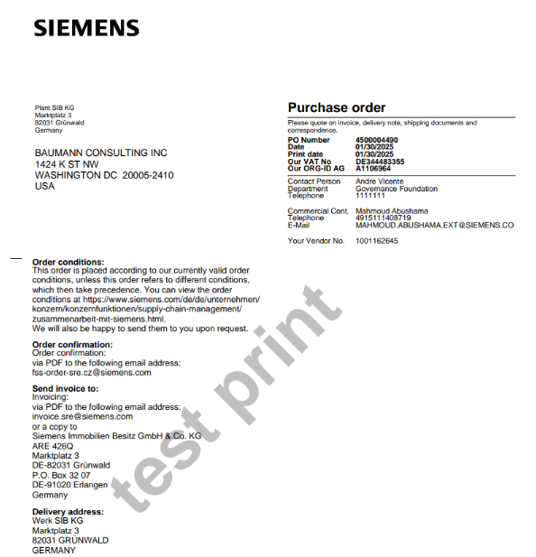
Purchase Order Output
Example of Printout
Feature Abstract & Rationale
Details
The different between the “YDFO” and “YDNB” document types are
The Form Title
Predefined Text “Order Condition”
“YDFO” has a validity period on header level
PO Doc Type: YDFO – Framework PO
PO Doc Type: YDNB – Direct PO

Slide 27
SHERPA X Governance Foundation FY 2025 Fit-2-Standard Workshop Agenda
UPDATED by Marcus 2025-01-21
1. Introduction Purpose of this Workshop Scope Sherpa X Organization Workstream Organization Release Plan and Increments P2R Direct X FY25 | Marcus Fiegert | 20 min
2. SRE Direct X Process and Solution PR Direct Solution Overview (Fiori, BTP, SAT, VIM) SRE P2R Process Create / Receive Purchase Requisition Create / Receive Purchase Order / Order Change Share Purchase Order with Supplier |  | 60 min
3. Next Steps |  | 20 min
4. Q&A |  | 20 min

Slide 28
There is only a short time frame to collect, analyze and sign off additional requirements.
To be UPDATED by Marcus (link to template)
Requirements Collection after this call (Fit/Gap):
There is a window of 1 week to receive feedback and requirements from you.
Please use the MS Teams Fit2Standard Meeting Q&A during the call.
After this call please use the xxxxxx list to record your questions and requirements. Due date is February 14, 2025 (eob).
Due to the short time frame, we can only focus on most critical requirements.
To provide answers to the questions we plan a second call in CW 08.
The requirements will be assigned to “Gaps” and “Fits” based on following criteria.
Finally, the requirements are uploaded to Polarion and scheduled for implementation.
Fit / Gap Classification | Definition
FIT | Fit to SHERPA X Standard
FIT Customizing | Fit to existing SHERPA X standard, but minor customizing effort to set up basic settings for a new company code.
GAP Customizing | Customizing needed to fulfill requirement.
GAP | Development needed to fulfill new requirement. Approved Decision request from GF Transformation Management required.

Slide 29
SHERPA X Governance Foundation FY 2025 Fit-2-Standard Workshop Agenda
UPDATED by Marcus 2025-01-21
1. Introduction Purpose of this Workshop Scope Sherpa X Organization Workstream Organization Release Plan and Increments P2R Direct X FY25 | Marcus Fiegert | 20 min
2. SRE Direct X Process and Solution PR Direct Solution Overview (Fiori, BTP, SAT, VIM) SRE P2R Process Create / Receive Purchase Requisition Create / Receive Purchase Order / Order Change Share Purchase Order with Supplier |  | 60 min
3. Next Steps |  | 20 min
4. Q&A |  | 20 min

Slide 30





SRE Direct X Q&A
UPDATED by Marcus 2025-01-17

Slide 31
Backup Slides

Slide 32
Definitions
To be UPDATED by Ajit
SAP S/4HANA (S4P)
SAP S/4HANA system is the main system in the SHERPAX landscape and S4P_100 is its production system. In the SRE Direct Procurement process, the Purchase Requisition and the Purchaser Order will be created and managed on S4P.
SAP BTP
SAP Business Technology Platform (BTP) is integrated with the SAP S/4HANA to manage the Purchase Order approval workflow. In addition, the SAP BTP will control process mandatory fields in the Purchaser Requisition and Purchase Order.
Additionally, there are integrations with other SHERPAX systems as follows:
SAT – Mendix
Signature Authorization Tool (SAT) is SHERPAX harmonized tool to manage the authorized approvers per each Company Code (ARE), Cost Center and Profit Center. The SAT will be used to determine the Purchase Order Functional and Technical approvers.
SAP VIM - OpenText (S4P)
SAP Vendor Invoice Management (VIM) is a part of SAP S/4HANA system (S4P), which manages the received invoices from the supplier. In SRE Direct Procurement process, the VIM workflows will manage the Service Confirmation and the Price Deviation.
SAP MDG (M4P)
SAP Master Data Management (MDG) controls the Master Data in SERPAX and M4P is its production system. Business Partner (Supplier) has to be created first in MDG and then it will be automatically replicated to S4P to be used in the SRE Direct Procurement.

Slide 33
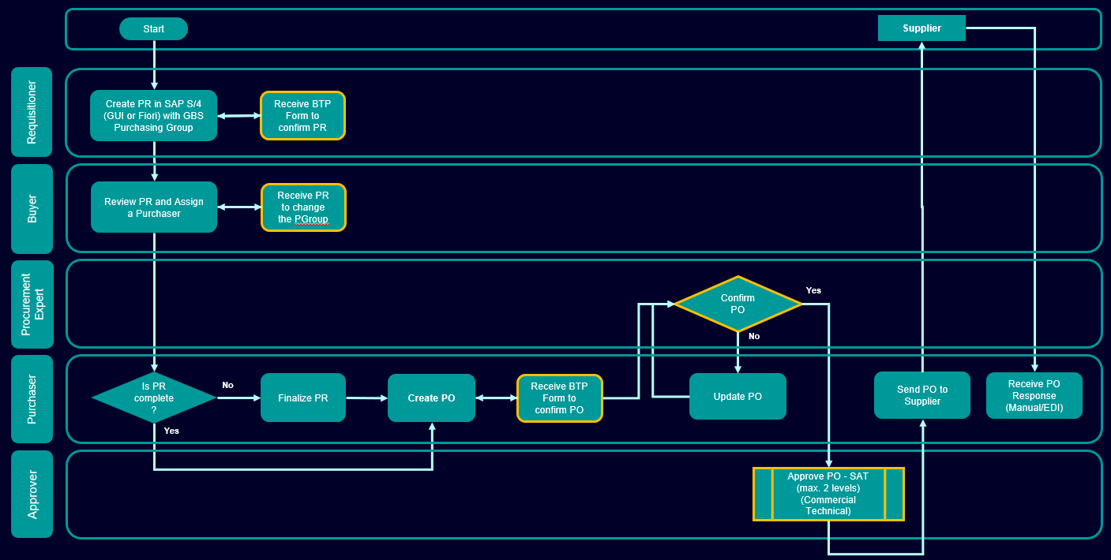
SRE Direct X Process
To be UPDATED by Ajit
SAP BTP

Slide 34
SRE Direct X Process
1
Start
Supplier
2
3
Requisitioner
Create PR in SAP S/4 with GBS Purchasing Group
Receive BTP Form to confirm PR
4
Buyer
Review PR and Assign a Purchaser
Receive PR to change the PGroup
Procurement Expert
Confirm PO
Yes
No
Purchaser
Is PR complete?
No
Finalize PR
Create PO
Receive BTP Form to confirm PO
Update PO
Send PO to Supplier
Receive PO Response
(Manual/EDI)
Yes
Approver
Approve PO - SAT
(max. 2 levels)
(Commercial
Technical)
SAP BTP

Slide 35
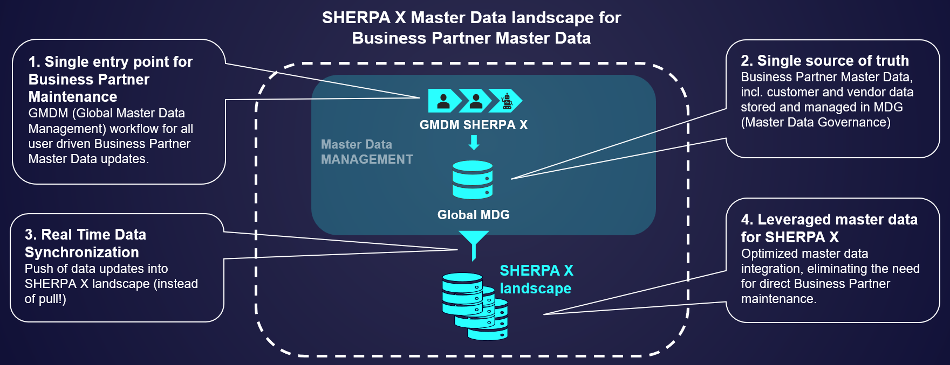
Supplier Master Data
Business Partner Master Data in S/4 HANA is replicated from corporate Master Data Governance system (MDG)
To be UPDATED and merged with previous slide by Ajit
Feature Abstract & Rationale
Details
Business Partners including internal and external suppliers are centrally managed in MDG
Creation and/or change of Business Partner data have to be executed in MDG first before such data is available in S4P system (e.g., Purchasing Organization, terms etc.)
(SRE) Direct X

Slide 36
SRE Direct X : Major interfaces
SAP S/4HANA (S4P) : SAP S/4HANA system is the main system in the SHERPAX landscape and S4P is its production system. In the SRE Direct Procurement process, the Purchase Requisition and the Purchaser Order will be created and managed on S4P.
SAP BTP : SAP Business Technology Platform (SAP BTP) is a comprehensive technology platform that integrates various services and tools to help businesses innovate and transform digitally, it is integrated with the SAP S/4HANA to manage the PR/PO forms & approval workflow.
SAT (Mendix) : Signature Authorization Tool (SAT) is SHERPAX harmonized tool to manage the authorized approvers per each Company Code (ARE), Cost Center and Profit Center. The SAT will be used to determine the Purchase Order Functional and Technical approvers.
SAP MDG (M4P) :Business Partners including internal and external suppliers are centrally managed in MDG Creation and/or change of Business Partner data have to be executed in MDG first before such data is available in S4P system (e.g., Purchasing Organization, terms etc.).
Master Data
Cloud connector
S/4 Hana (S4P)
SAP BTP
Via OCI Punchout only
MDG
Suppliers master
myMall
SAT

Slide 37
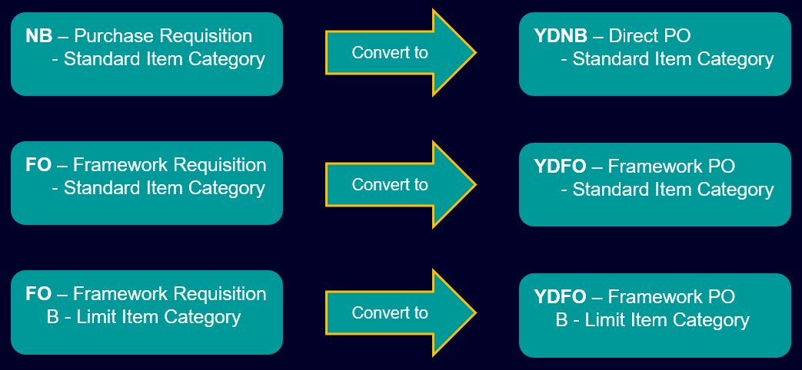
Definitions for SRE Direct X template
To be UPDATED by Ajit
P2R Process Roles:
PR / PO Document Types in S4P:
Role | Description
Requisitioner | Processes Purchase Requisitions (PR)
Buyer | Executes buying activities (eg retrieves quotes from supplier, determines sources)
Procurement Expert | Involved in predefined use cases in PR or PO to validate and update data for dedicated purpose
Purchaser | Processes PR and creates PO, Order Confirmations and Claims/Returns
Approver | Approves POs based on a signature mandate
Purchasing Organization (Purch Org):
Purchasing Groups:
Notes
no IM** Purch Orgs
Purchase Org for 426Q/3003 = C300
Purch Orgs per company code
Notes
represents a buyer or a group of buyers responsible for specific proc. activities
PR: Fxx – SRE Functional Group
PO: individual groups are used to assign a PR to the respective Purchaser (Ixx)

Slide 38

SRE Direct Process
Start
Requisitioner
Create PR in SAP S/4 & Review the PR details in BTP
Buyer
Assign PR to individual Purchaser
Expert
Procurement Expert confirms PO
Yes
Purchaser
Is PR complete?
NO
Finalize PR
Create PO
Purchaser reviews the PO
Is PO >50K EUR ?
No
Yes
Approve PO - SAT
(max. 2 levels)
(Commercial
Technical)
Send PO to supplier via Print/EDI/Email
Supplier
Approver
PO response

